Slide 1
Data Analytics
Evolution of Analytic Scalability
S.V.Jansi Rani
Assistant Professor / CSE
Notes:
The University of Adelaide, School of Computer Science
Chapter 2 — Instructions: Language of the Computer

Slide 2
Outline
History of Scalability
Convergence of analytic and data environment
Massively Parallel Processing Systems
Cloud Computing
Grid Computing
MapReduce

Slide 3
History of Scalability
Amount of data grows with computing power of the machines
In 2000 – terabyte of data
Petabyte -> Exabyte->Zettabyte ->Yottabyte -> entire internet makes up about a yottabyte

Slide 4
Outline
History of Scalability
Convergence of analytic and data environment
Massively Parallel Processing Systems
Cloud Computing
Grid Computing
MapReduce

Slide 5
Convergence of analytic and data environment
Data set and a table - rows and columns.
A single row represents an entity like a customer.
A column represents information about the customers.
Analysts do data preparation.
In this process they pull data from various sources and merge it all together to create the variables required for an analysis.
Traditional analytics (DW) - process -extract, transform and load (ETL).
RDBMS is the standard for managing data.
Most data used in analysis is now obtained from a relational database.
Single purpose databases are often called data marts.
Combining the various database systems into one big system called an Enterprise Data Warehouse (EDW).

Slide 6
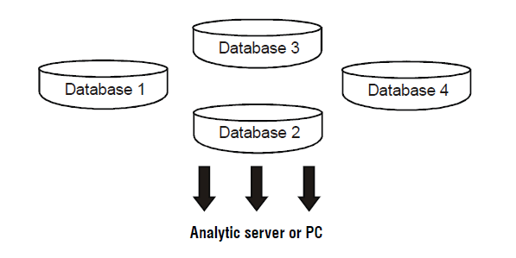
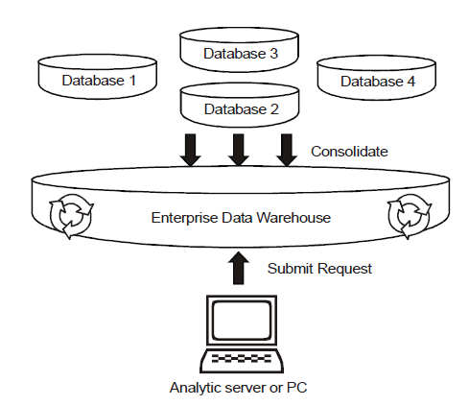
Traditional Analytic Arch
Modern In-Database Arch

Slide 7
Outline
History of Scalability
Convergence of analytic and data environment
Massively Parallel Processing Systems
Cloud Computing
Grid Computing
MapReduce

Slide 8
Massively Parallel Processing Systems
MPP is the most mature, proven and widely deployed mechanism for storing and analyzing large amounts of data.
MPP database -independent pieces managed -
independent storage and CPU resources.
MPP - segment the data - multiple servers – each server node can work independently of the others.
For example,
  JOIN between a large table and a small table, an MPP database will store on each node a subset of rows from the large table, along with a copy of the entire small table
Each node can then perform the JOIN independently of the other nodes, thus eliminating the bottlenecks created by shared resources.

Slide 9
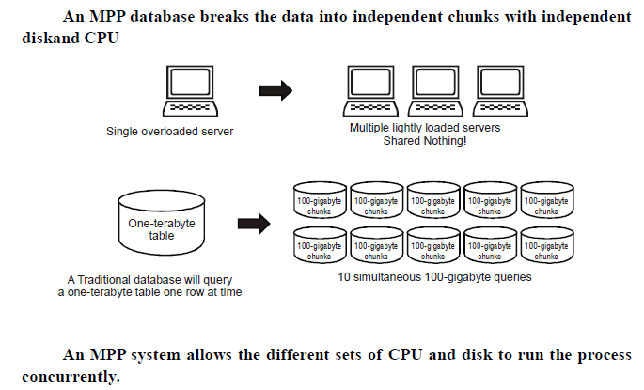

Slide 10
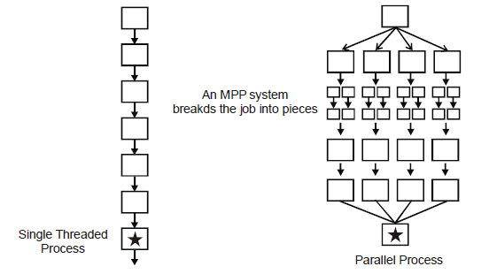

Slide 11
Using MPP Systems for data preparation and scoring
Data preparation is made up of joins, aggregations, derivations and transformations – pull together
Aggregations involve combining information from multiple records in to one.
Derivations and transformations involve actions such as computing ratios like sales per transactions.
Today’s SQL can handle most.
The use of SQL is where in database processing started on MPP systems.
There are SQL functions called windowed aggregates that enable a query to account for data elsewhere when processing a given row

Slide 12
There are 4 primary ways for data preparation and Scoring:
SQL pushdown
User Defined Functions(UDF’s)
Embedded Processes
Predictive modeling markup language*(PMML) scoring

Slide 13
SQL Push down
SQL is the native language of an MPP system
Data preparation tasks -translated into SQL by the user from model or -an analytic tool can generate SQL on the users behalf and ‘push it down’ to the database
Example: Linear Regression , logistic regression , decision trees

Slide 14
User Defined Functions:
UDF extend SQL functionality by allowing a user to define
logic that can be executed in the same manner as a native SQL function. – C++ / Java
A request for total sales by customer might be written as “Select customer,Attribute score….”
● User defined functions are coded in languages like C++ or java.

Slide 15
Embedded process
Higher level of integration than UDF
An Embedded process is a version of an analytic tools engine actually running on the database itself.
An embedded process is capable of running programsdirectly inside the database.

Slide 16
PMML
PMML is a way to pass model results from one tool to another.
Conceptually it contains the minimum information needed to produce an accurate piece of scoring code.
The type of information included in a form of PMML feed - model type, the variable names and formats and the parameter values.
pass the PMML from the first tool to the second tool and the second tool will automatically generate a scoring process
One drawback of PMML is not immediately apparent.
The exact same variables in the exact same format must be available in the system where the model and PMML were generated.

Slide 17
Outline
History of Scalability
Convergence of analytic and data environment
Massively Parallel Processing Systems
Cloud Computing
Grid Computing
MapReduce

Slide 18
Cloud computing
Cloud computing is a new form of Internetbased computing that provides shared computer processing resources and data to computers and other devices on demand.
3 criteria for cloud envmt
  Only operational cost on pay-per-use basis
  Capacity scaled up
  Hardware can be anywhere –multi-tenancy mode
National Institute of Standards and Technology (NIST) list 5 characteristics of cloud environment:
  On-demand self-service
  Broad network access
  Resource pooling
  Rapid elasticity
  Measured service

Slide 19
Cloud Types
Public Cloud
  The services and infrastructure are provided off-site over the internet
  Greatest level of efficiency in shared resources
  Less secured and more vulnerable than private clouds
Private Cloud
  Infrastructure operated solely for a single organization
  The same features of a public cloud
  Offer the greatest level of security and control
  Necessary to purchase and own the entire cloud infrastructure

Slide 20
Outline
History of Scalability
Convergence of analytic and data environment
Massively Parallel Processing Systems
Cloud Computing
Grid Computing
MapReduce

Slide 21
Grid Computing
More analysis – more servers – grid configuration – cost and performance
One job – one server -> each machine – fraction of job
Not for intensive jobs
New innovation – high performance analytics arch of grid

Slide 22
Outline
History of Scalability
Convergence of analytic and data environment
Massively Parallel Processing Systems
Cloud Computing
Grid Computing
MapReduce

Slide 23
MapReduce
MapReduce is a parallel programming model introduced by Google for processing and generating large data sets on clusters of computers
Map function
Processing a key/value pairs to generate a set of intermediate key/value pairs
Reduce function
Merging all intermediate values associated with the same intermediate key
How map reduce works:
Let’s assume there are 20 terabytes of data and 20 Map Reduce server nodes for a project
Distribute a terabyte to each of the 20 nodes using a simple file copy process

Slide 24
Submit two programs(Map, Reduce) to the scheduler
The map program finds the data on disk and executes the logic it contains
The results of the map step are then passed to the reduce process to summarize and aggregate the final answers

Slide 25
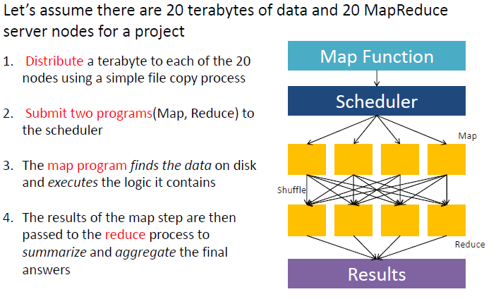

Slide 26
Strengths
Lots of input, intermediate, and output data
Batch oriented datasets (ETL: Extract, Load, Transform)
Cheap to get up and running because of running on commodity hardware

Slide 27
Weaknesses
Fast response time
Large amounts of shared data
CPU intensive operations (as opposed to data intensive)
NOT a database!
No built-in security
No indexing, No query or process optimizer
No knowledge of other data that exists

Slide 28
Thank You

